Slide 1
PLL
Santhosh R Chavalla

Slide 2
Contents
Simulations:
Complete PLL
VCO
Charge Pump/Loop Filter
PFD
Frequency Divider

Slide 3
Simulations

Slide 4
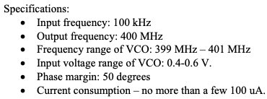

Slide 5
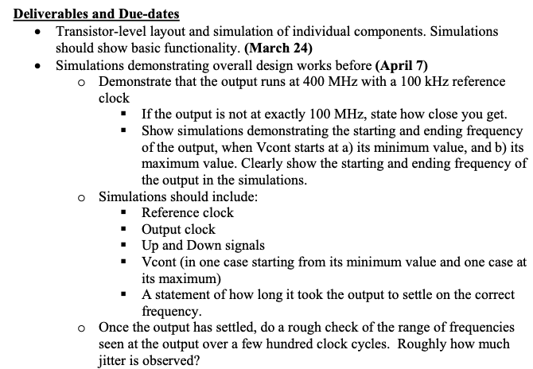

Slide 6
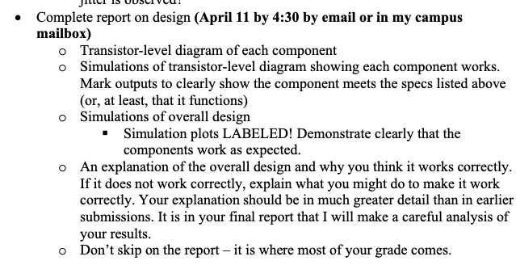

Slide 7
Complete PLL

Slide 8
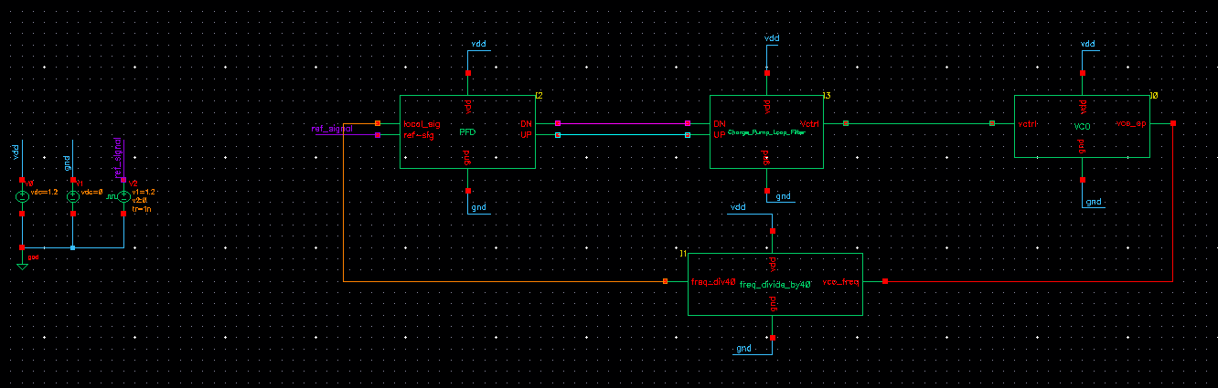
reference signal-10MHz signal
initial condition on VCO feedback loop
1. vctrl=0.4 initial condition (adel>simulation>convergence aids>initial condition), transient simulation: 2.3u
2. vctrl=1.2v initial condition transient simulation: 2.1u

Slide 9
Specifications | Designed for
VDD | 1.2 V
Loop Gain
Loop Bandwidth | 928 KHz
KVCO (individual) | 200M-450M ( Vctrl = 0.4V-1.2V)
Phase Margin | 50 degrees (50.44 degrees)
VCO Bandwidth (individual) | 508MHz(1.2V)-84MHz(0.4V) = 424MHz
Vctrl time to settle (Reference signal= 10MHz) | 1 us (vctrl_initial=1.2V) redo, 2.15us (vctrl_initial=0.4V)
Freq Jitter
Order | 3
Lock Time

Slide 10
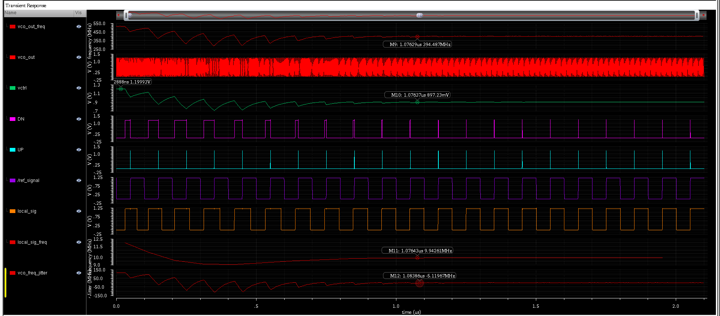
vctrl initial condition=1.2V

Slide 11
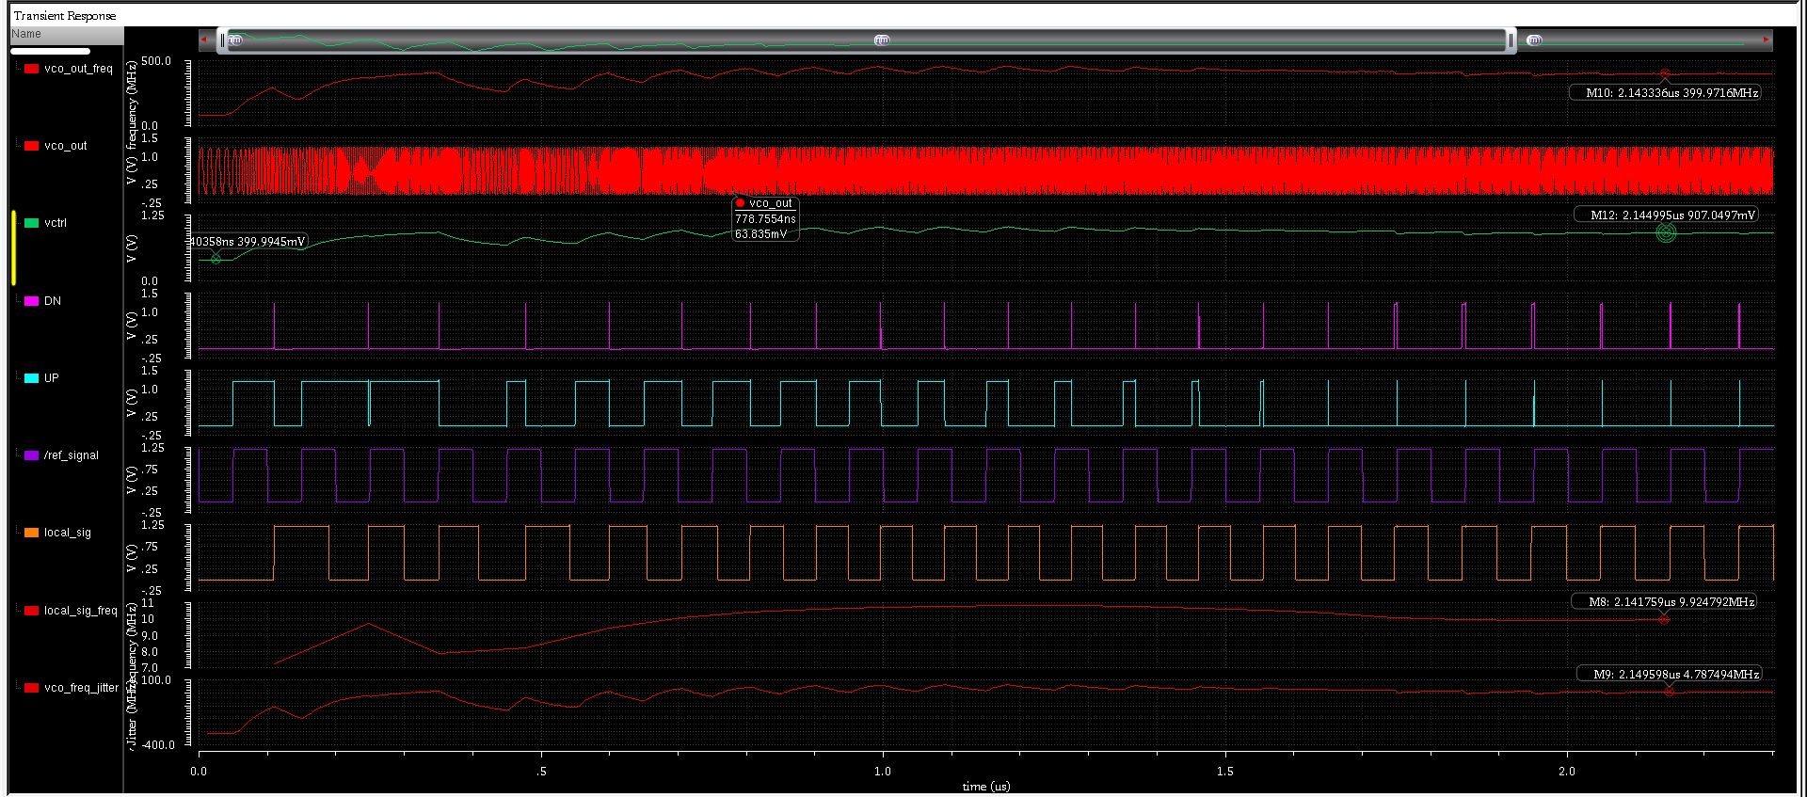
vctrl initial condition= 0.4 V

Slide 12
Phase Noise

Slide 13
VCO

Slide 14
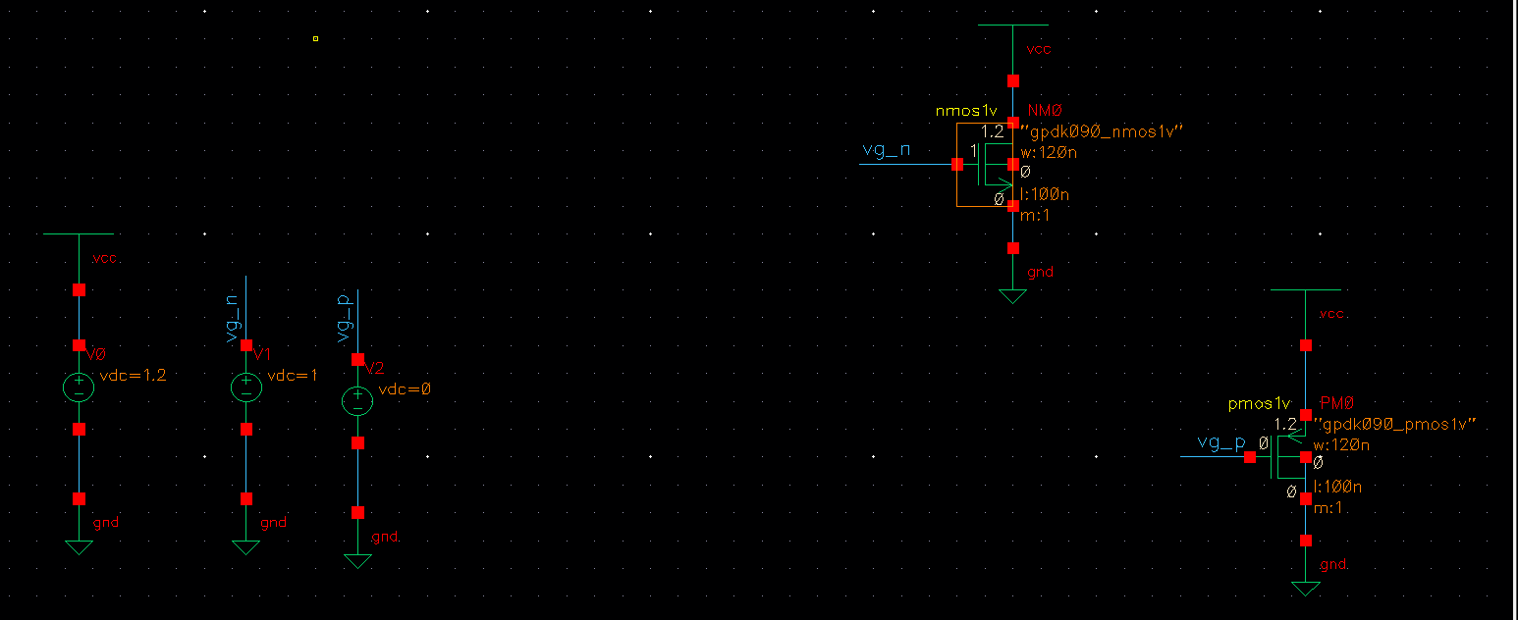
Step:1
dc simulation > results > print > DC operating points > select FET
verify that both are in sat region (region 1,2(saturation),3)
take betaeff, cgs, cgsov (theory from Rabaey)

Slide 15
Step:2
vctrl=0.8v
ran the setup(dc simulation) with min sized FETS
NMOS not in saturation due to large drop across VDS of PMOS
increased PFET size to pump more current in the ckt, hence drop across NMOS will increase (NMOS size kept same)
As expected current increased (show by writing eq), drop acros VDSp decreased and VDSn increased and NMOS now in saturation, note down this current

Slide 16
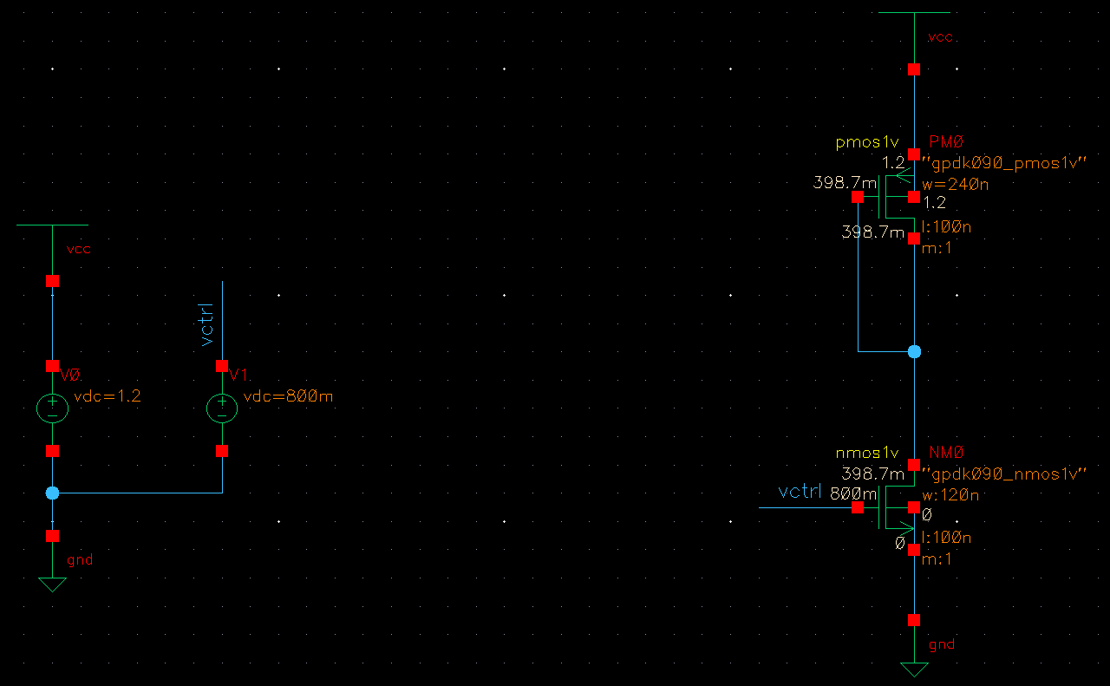
from dc simulations>print dc operating point>Id=43.27uA
NMOS in saturation

Slide 17
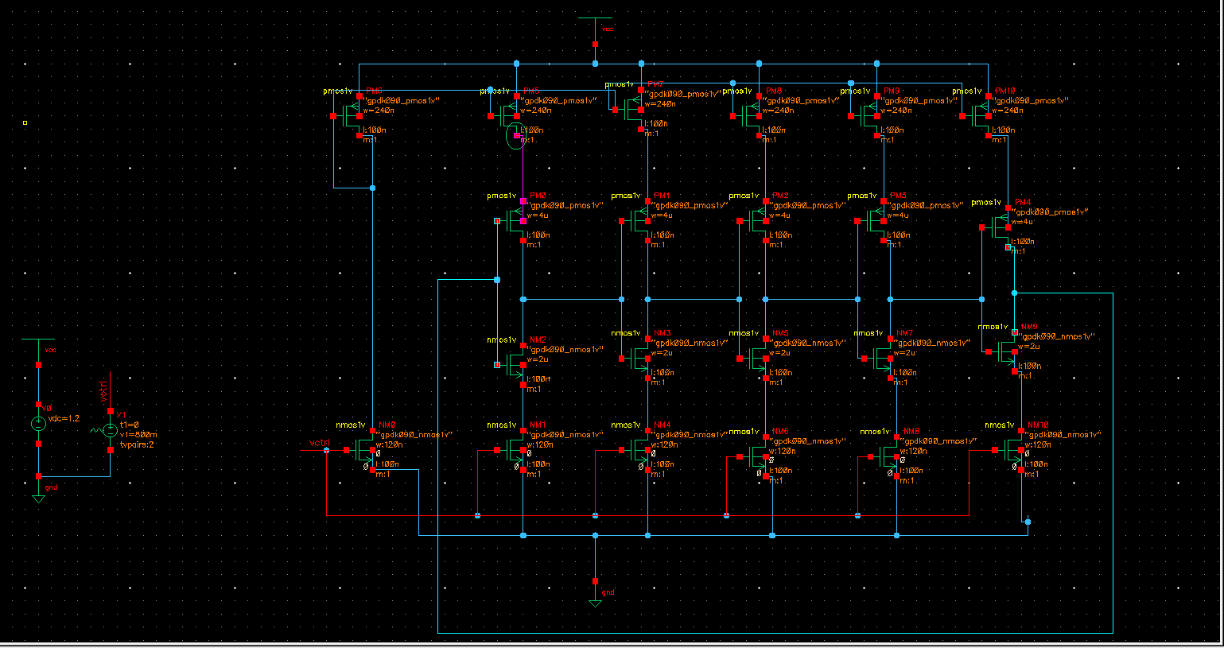

Slide 18
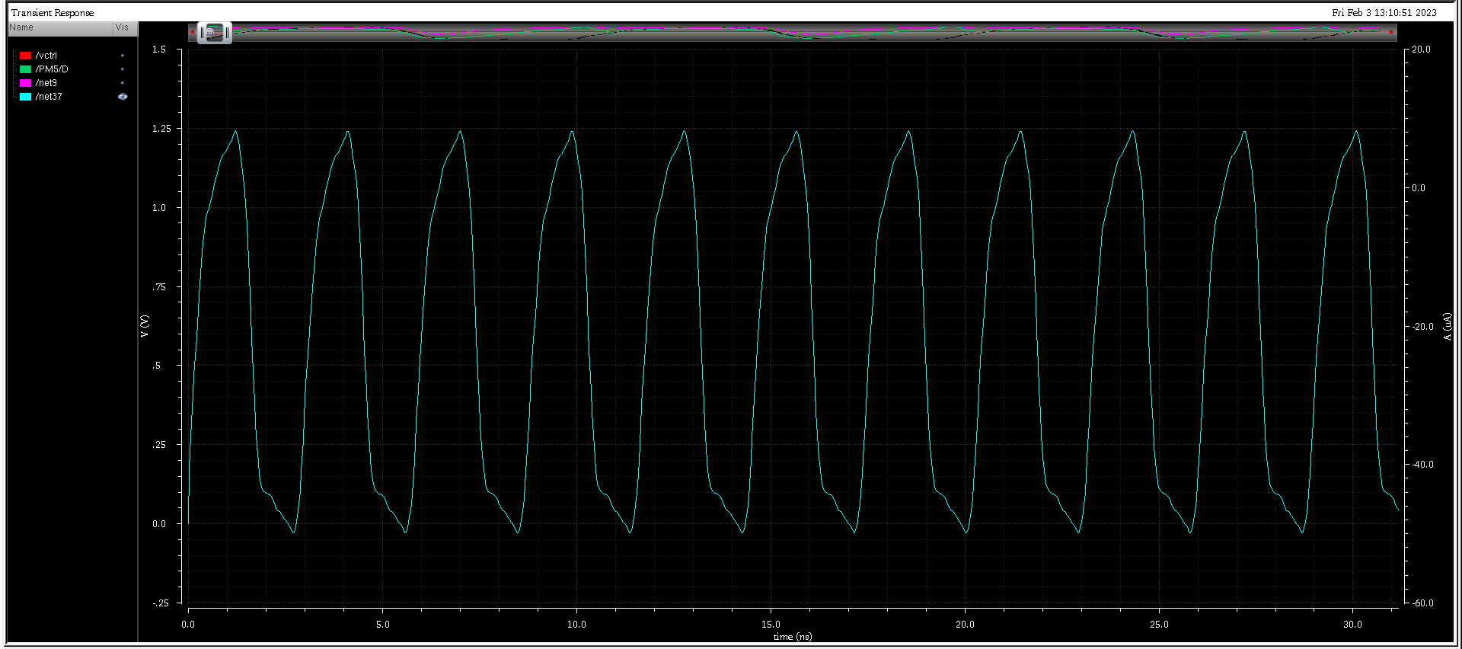
VCO_Output Waveform

Slide 19
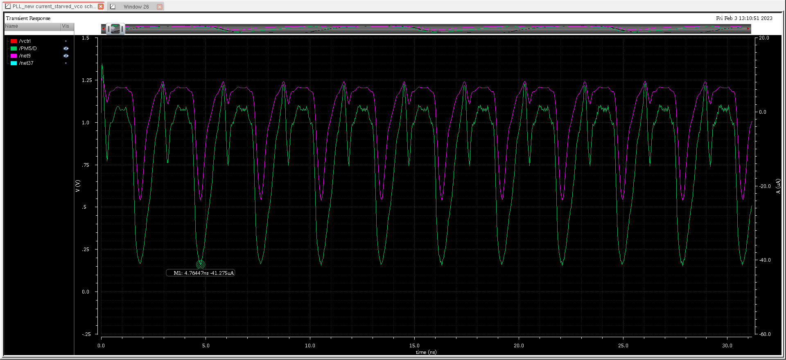
id (copied current mirror,original),vdrain of copied current mirror)

Slide 20
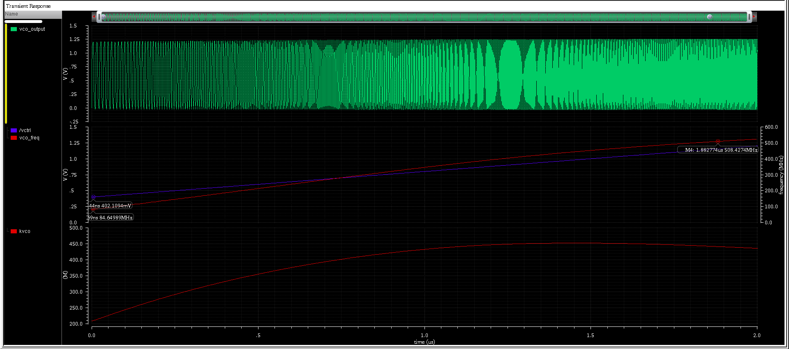
Designed for 400MHz @ 0.8V got 400MHz @895mV

Slide 21
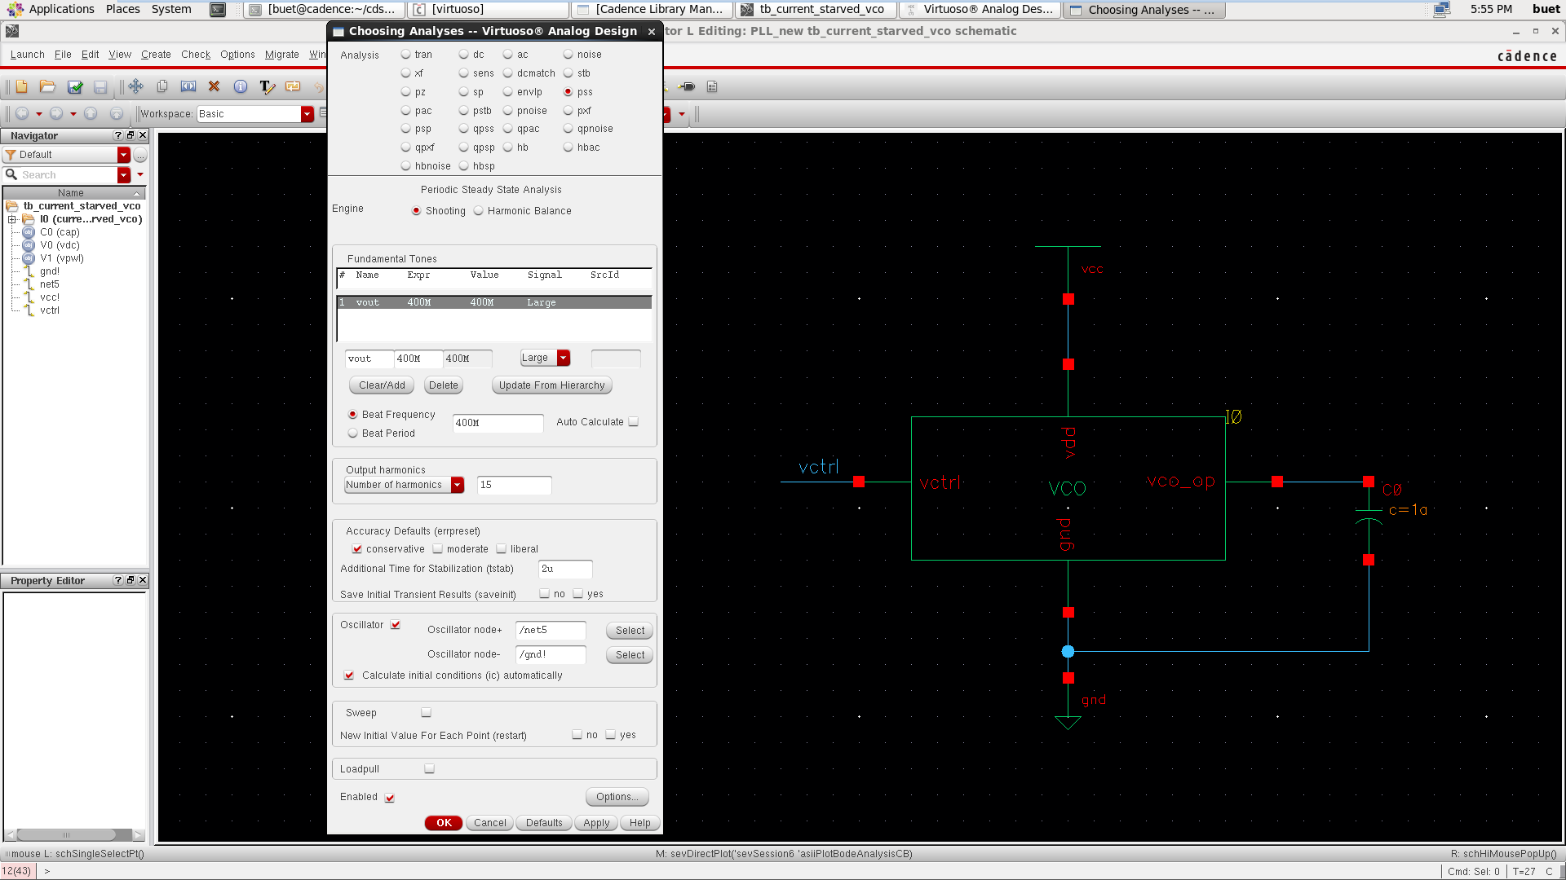
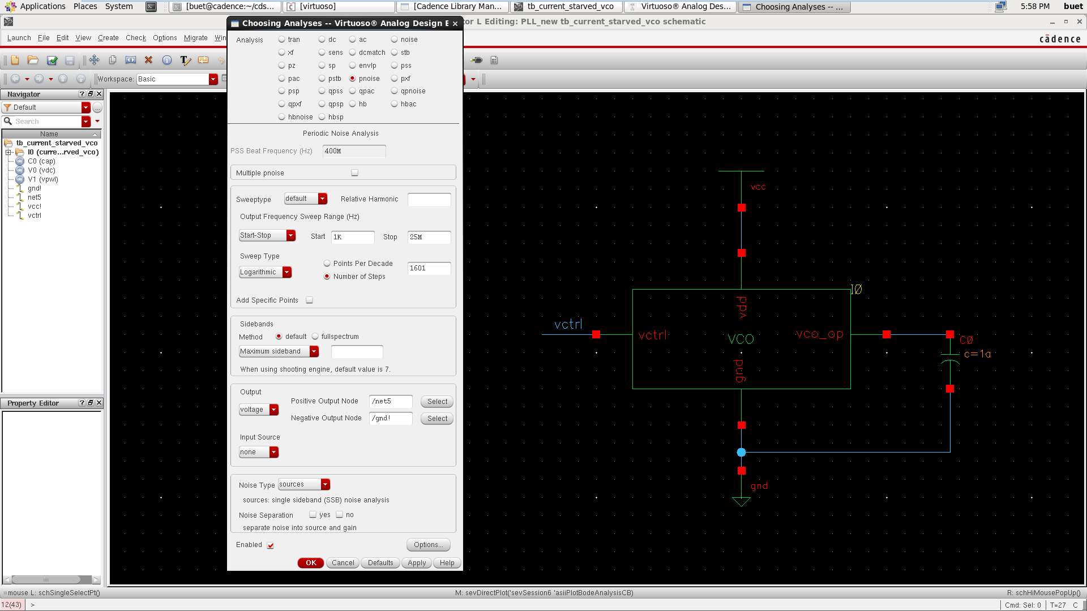
Now, in order to simulate the VCO Phase-Noise we need to perform the PSS, PNoise simulations.
For the PSS simulation, in the ADE window click on the AC,DC,Tran icon on the right pane. Choose the ‘pss’ simulation type, pick the parameters using those shown in Figure.
It is critical to note that the beat frequency here is the target frequency of the VCO and the reason we have to check the ‘oscillator’ option and select ‘vout’, ’gnd’ terminals from the schematic is because by default PSS simulation expects a differential output.
To run the PNoise simulation, in the ADE window click on the AC,DC, Tran icon on the right pane. Choose the ‘pss’ simulation type, pick the parameters using those shown in Figure 7.24(b).
Its critical to note that the phase-noise in the VCO is only dominant in the low-pass thus we limit our simulation frequency range to be from 1kHz to 10MHz as after the 10MHz the phase-noise will not cause any significant degradation to oscillator output performance.

Slide 22
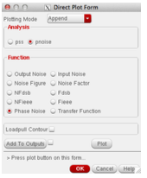
Note: To view the PNoise simulation results in the main ADE window click on Results → Direct Plot → Main Form at which a window like Figure 7.25. Choose ‘Phase-Noise’ and click on the ‘Plot’ button.

Slide 23
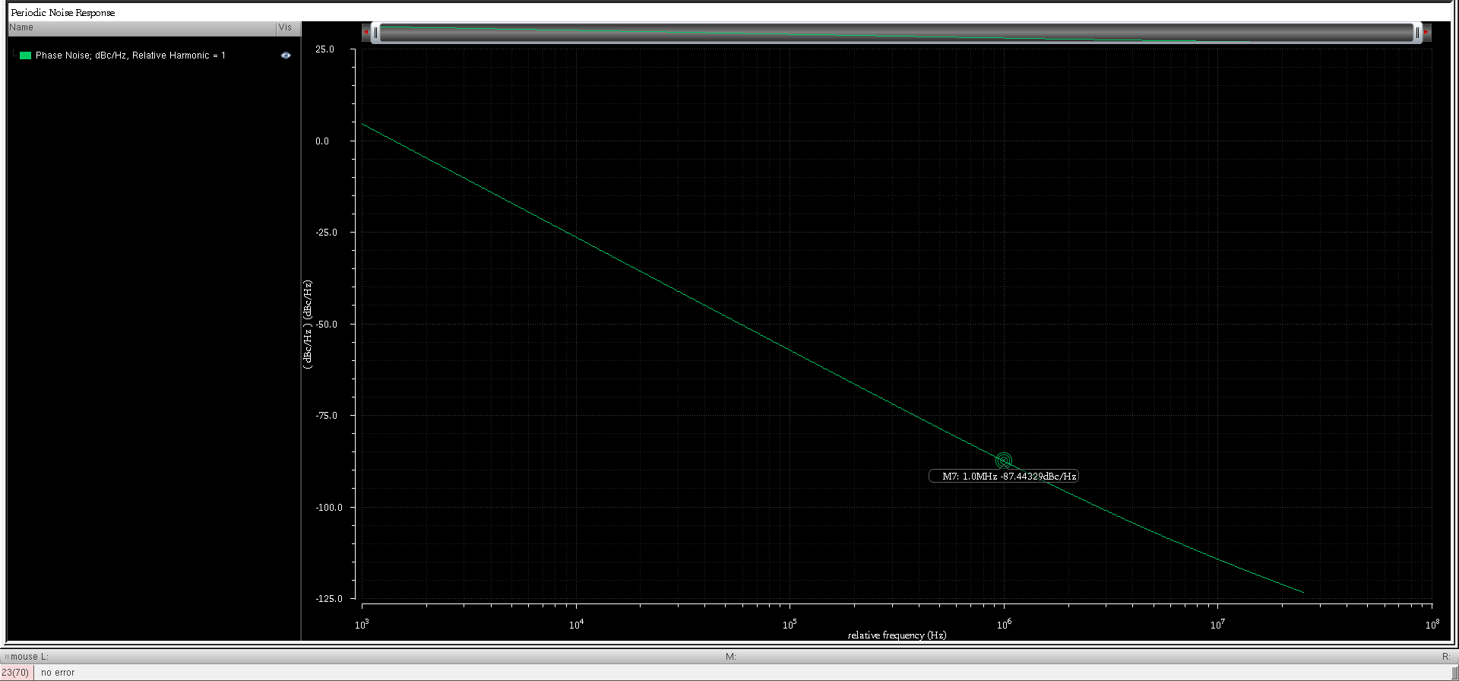
VCO Phase noise
-87.4dBc/Hz @1 MHz offset

Slide 24
Charge Pump + Loop filter

Slide 25

Step:1
draw current mirror circuit and optimize vgate of NMOS for both devices to be in saturation region
target current in the ckt to be very large 100's of uA
Step:2
UP and DN are given with pulse width of 50ns, both are not ON at same time
draw circuit and simulate(initially assume all current is being copied)> based on current being copied optimize values of loop filter

Slide 26
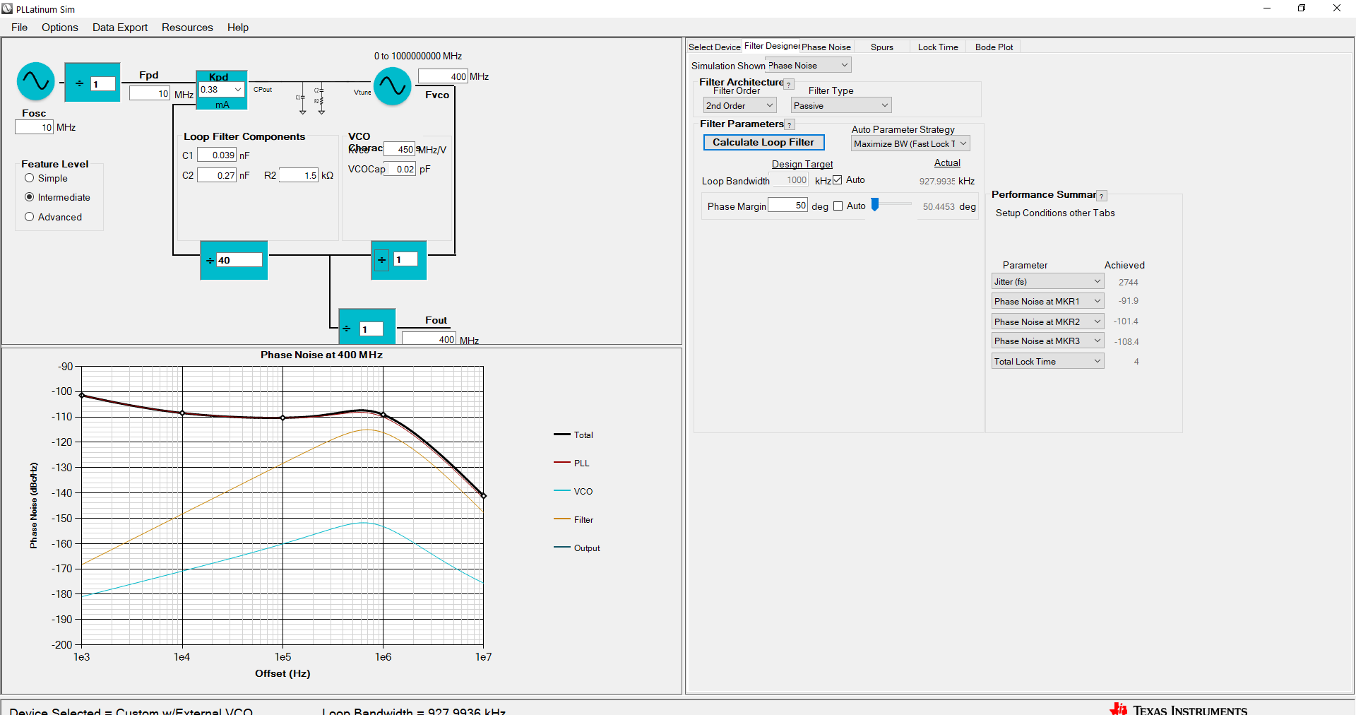

Slide 27
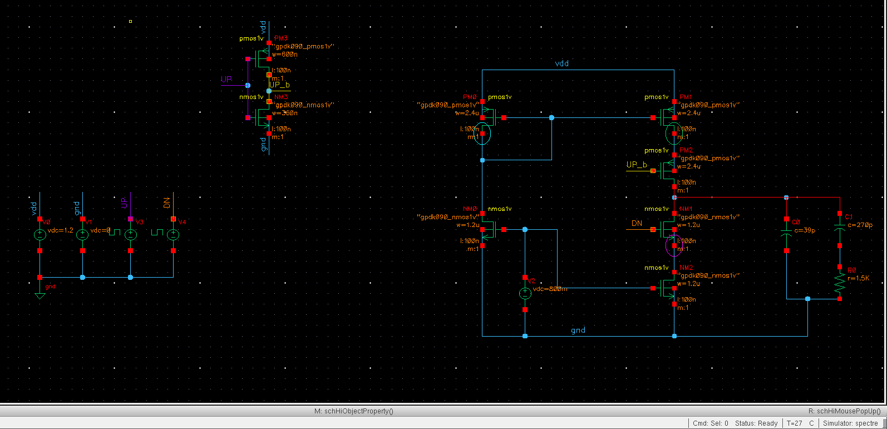

Slide 28
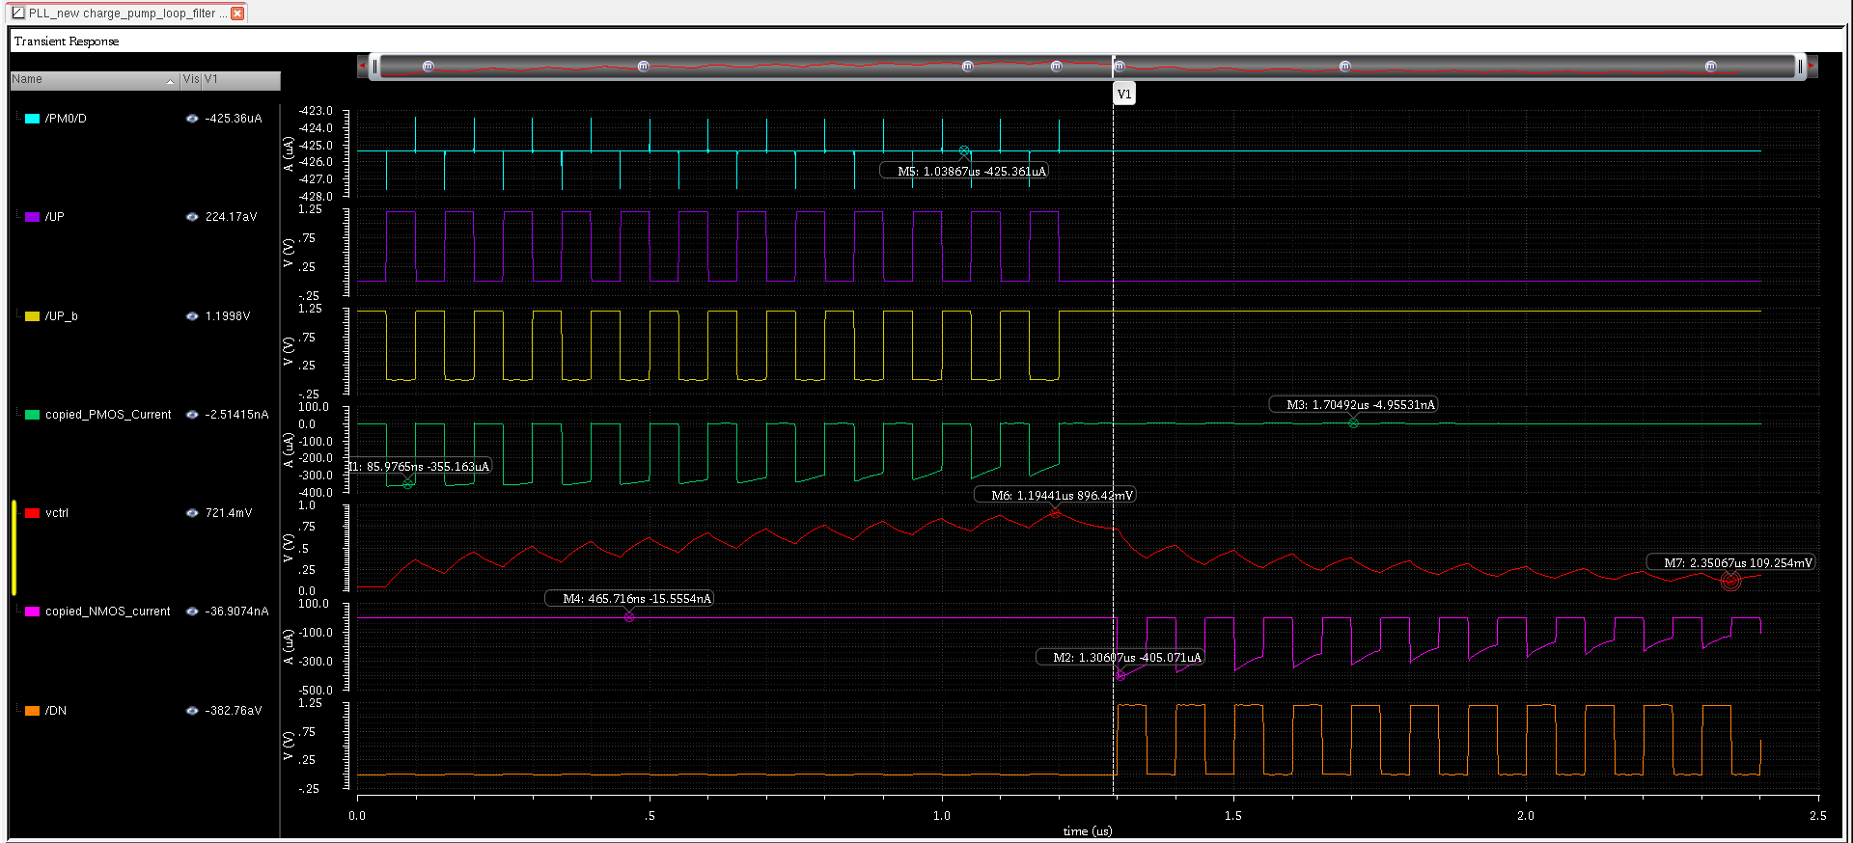

Slide 29
Phase and Frequency Detector

Slide 30
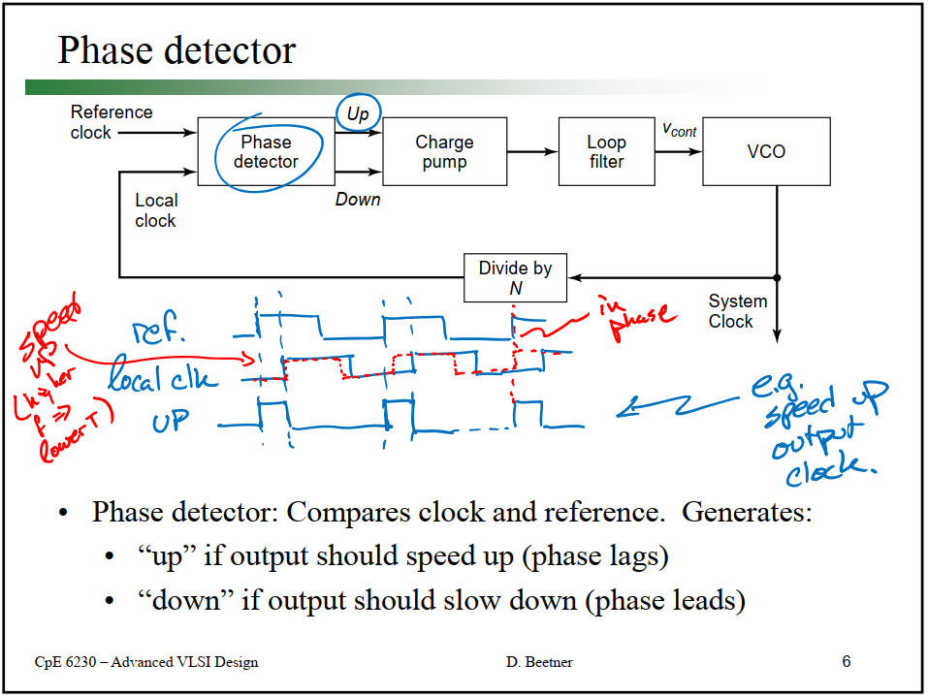

Slide 31
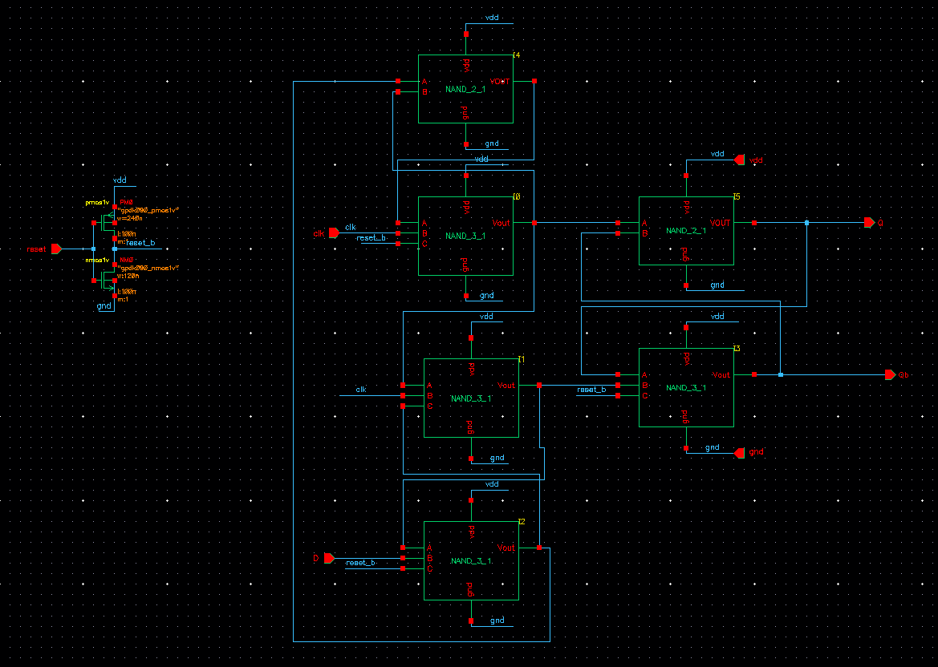
D_FF_pos_edge_Reset

Slide 32
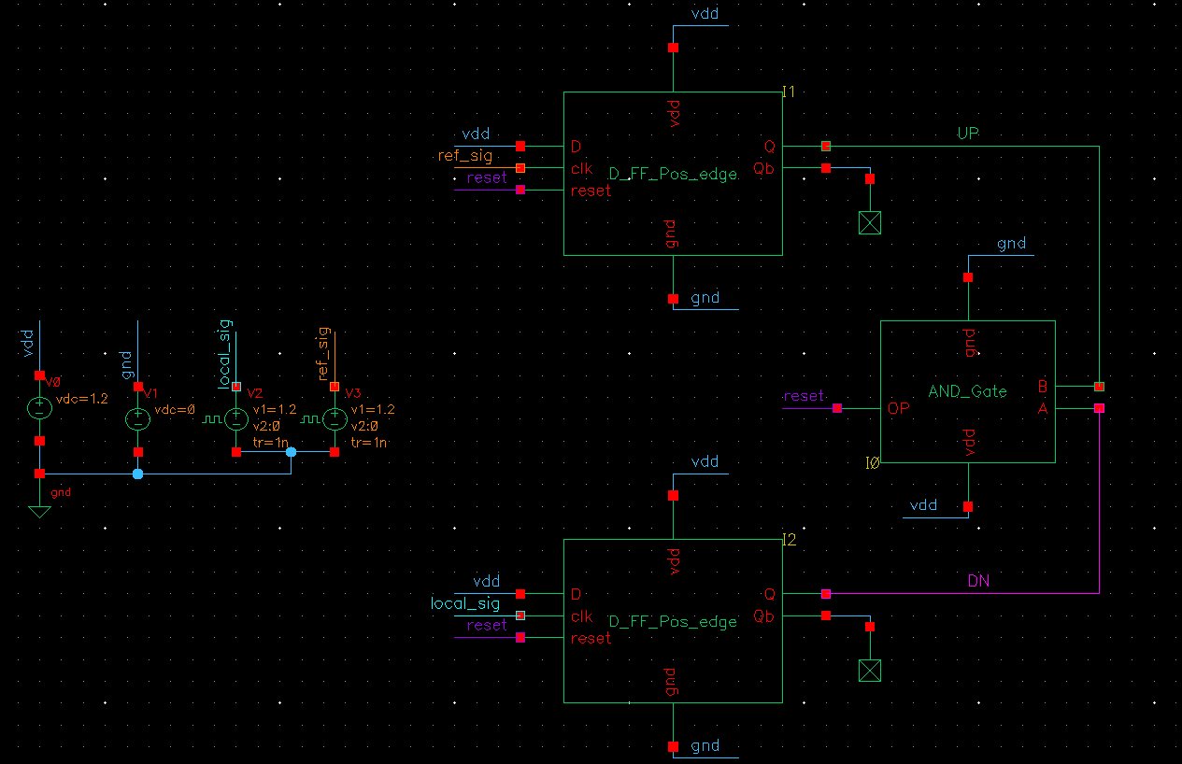

Slide 33
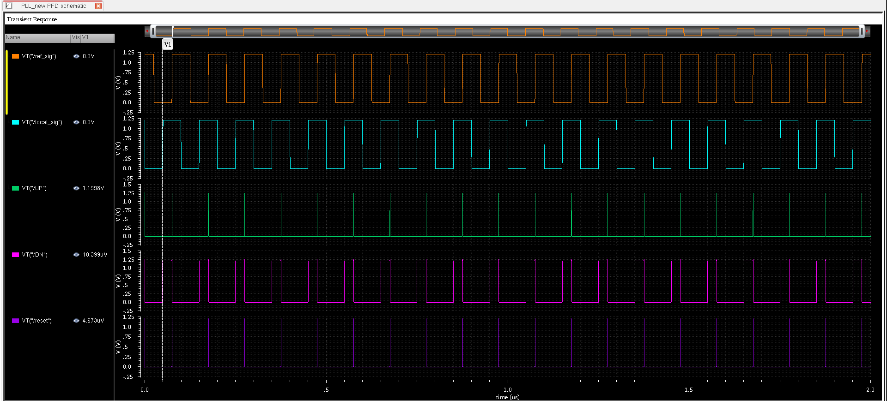
Initial conditions from adel>simulation>convergence aids>initial condition>0 (UP/DN)

Slide 34
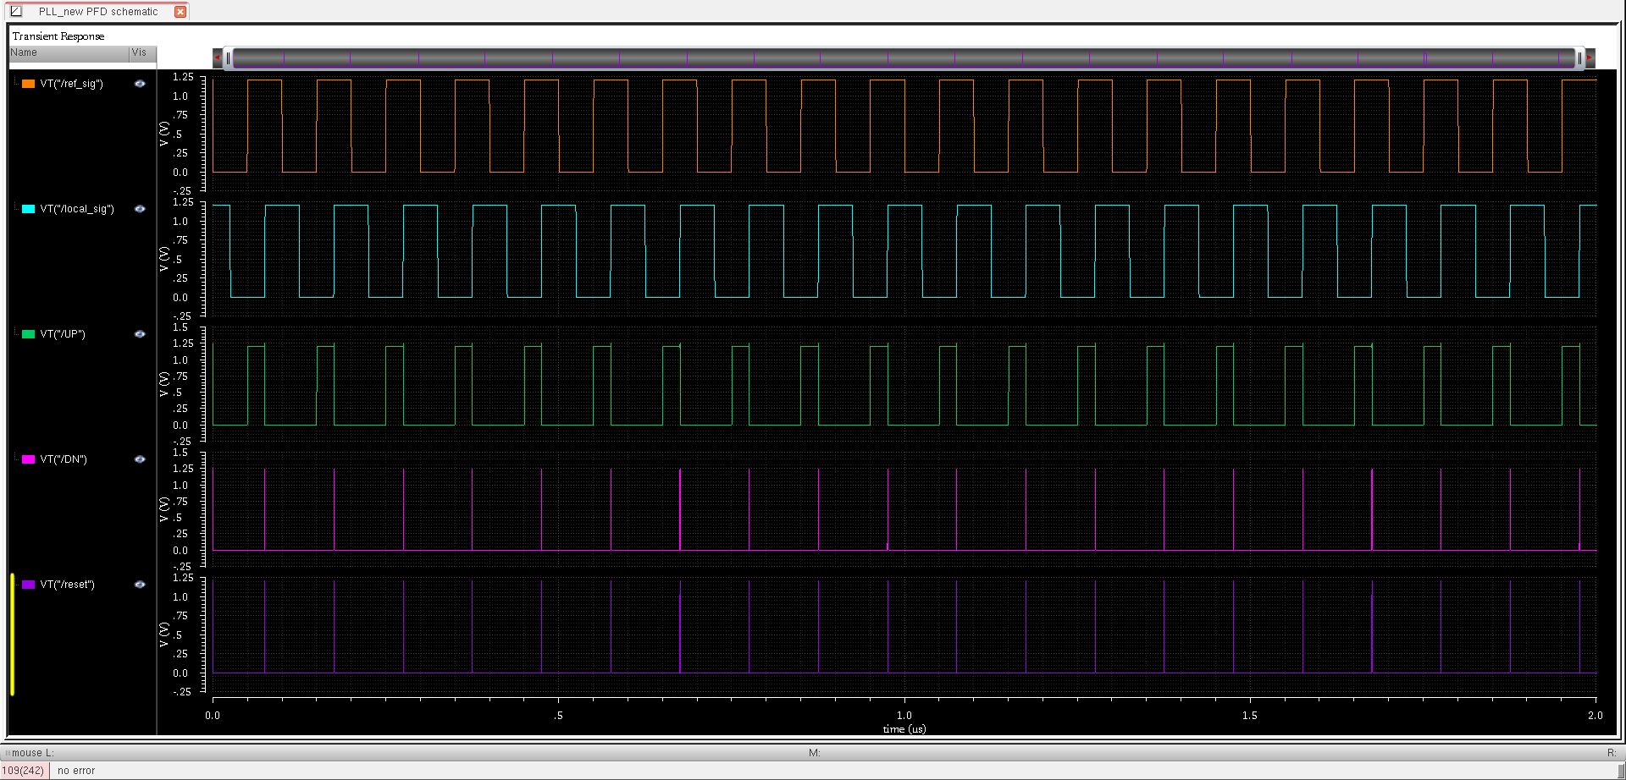

Slide 35
Frequency Divider

Slide 36
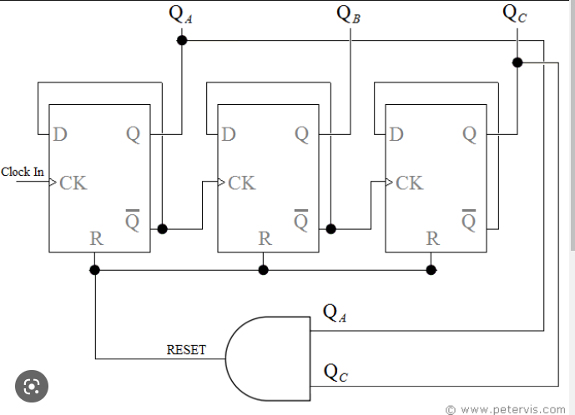
Assume initial condition: Q=0,Qb=1
Mod-5 counter

Slide 37
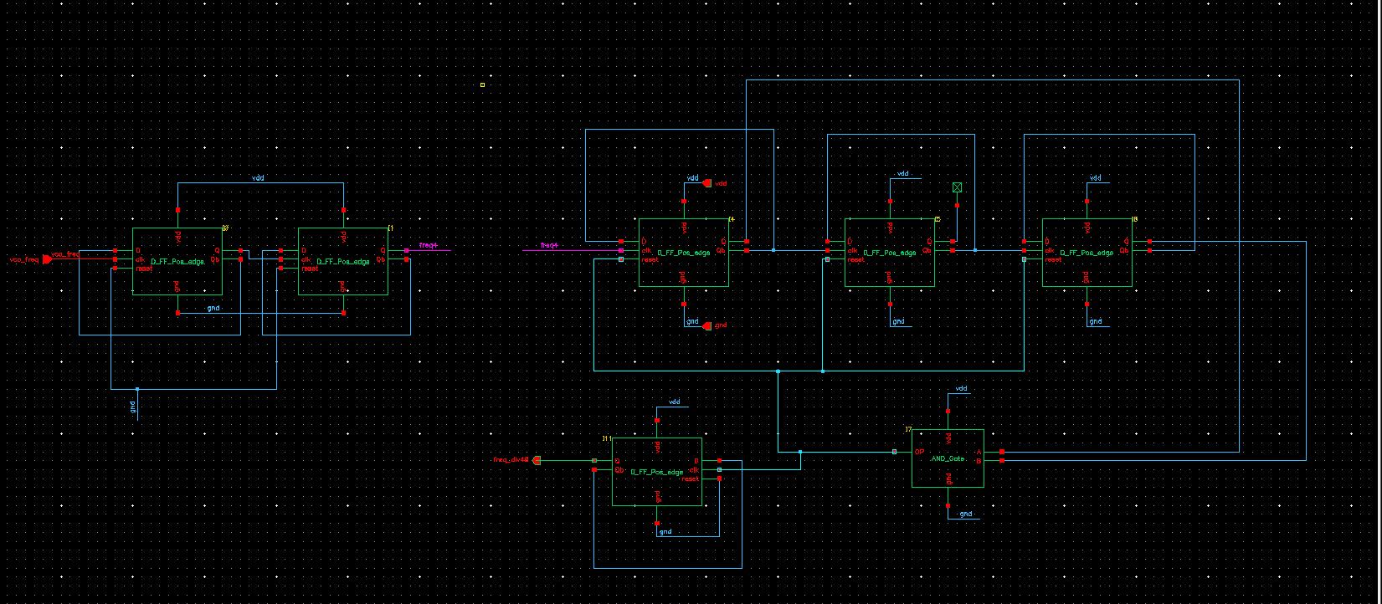
Divide by 40 is built by cascading divide by 4 and divide by 10
Divide by 10 is built by using mod-5 counter cascaded by divide by 2 D-flipflop
The AND gate detects 5th stage and reset mod-5 counter and toggles the last D-flipflop as it is connected to the
clk pin of it
Divide by 10
Divide by 4
Final op

Slide 38
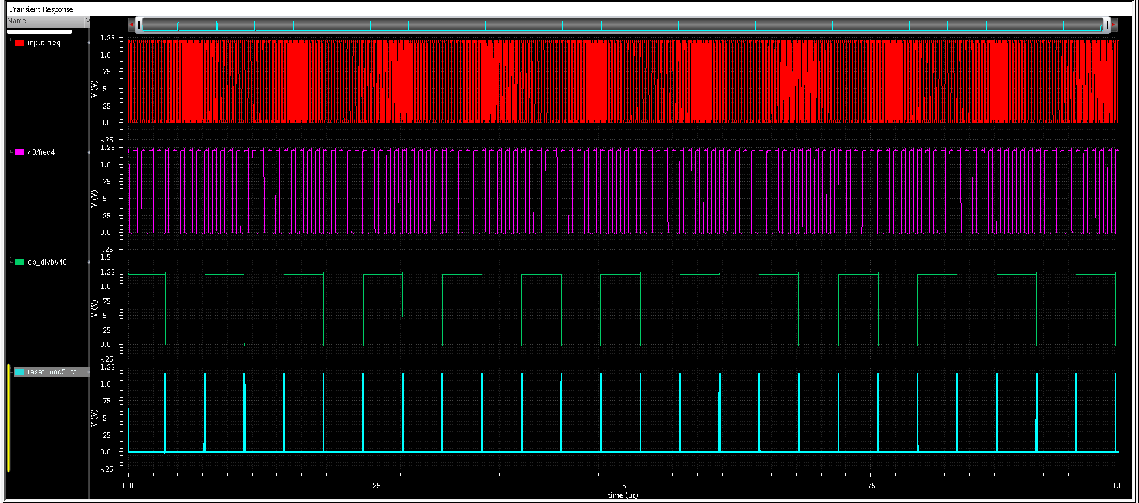

Slide 39
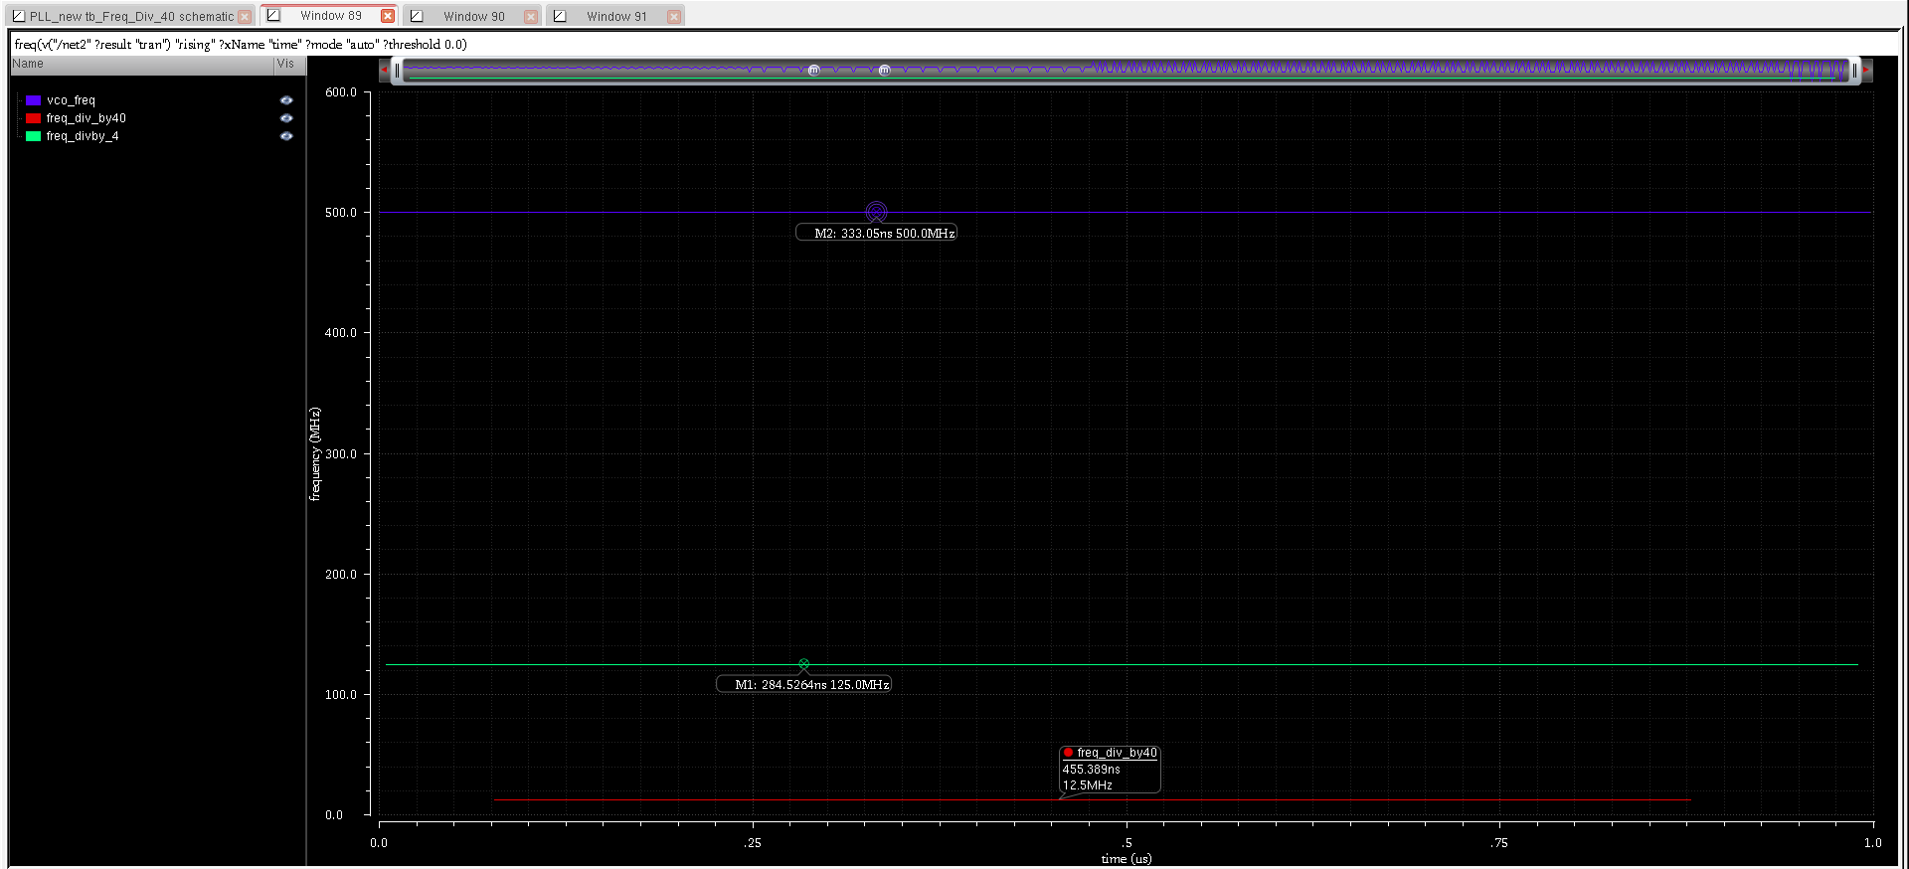

Slide 40
D_FF with NAND gates
Reset_b

Slide 41
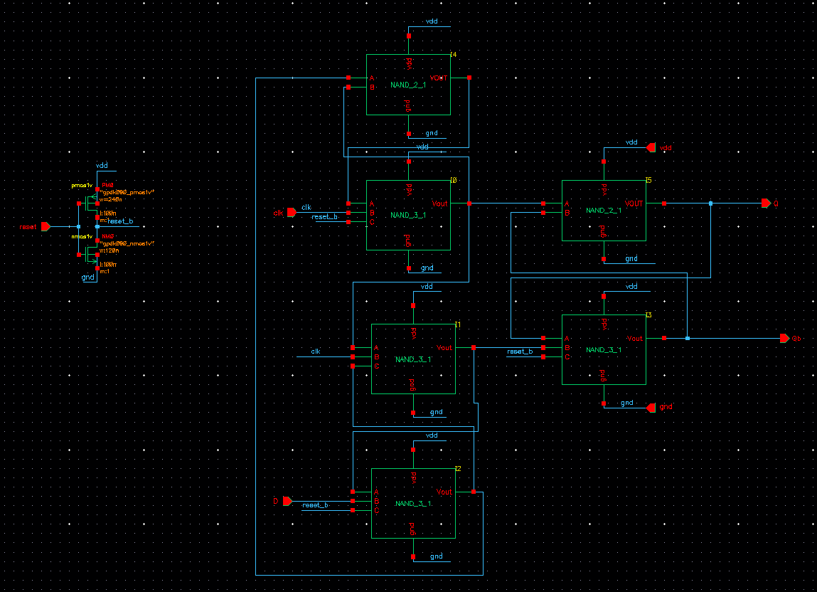
D_FF_Active_High Reset

